Slide 1
S.V.SOWMIYA NARAYANAN
Final Project

Slide 2
PROJECT TITLE
PHOTOREALISTIC FACE GENERATION USING DCGAN

Slide 3


AGENDA
Problem Statement
Introduction
Objective
How DCGAN Works
Applications
Conclusion and Future Work
3/21/2024 Annual Review

Slide 4

PROBLEM STATEMENT
Generating realistic human faces from random noise presents a formidable challenge in the field of computer vision. The primary hurdle lies in maintaining crucial elements such as facial structure, features, and overall realism throughout the generation process. Traditional methods often struggle to produce convincing results, lacking in diversity and authenticity. Addressing this issue requires advanced techniques that can capture intricate details while preserving the inherent characteristics of human faces. Overcoming these challenges is essential for applications ranging from entertainment to security, where lifelike facial synthesis plays a pivotal role in enhancing user experiences and ensuring effective solutions.

Slide 5

PROJECT OVERVIEW
INTRODUCTION:
Photo realistic Face Generation using Deep Convolutional Generative Adversarial Networks (DCGAN) revolutionizes the landscape of artificial intelligence by enabling the synthesis of lifelike human faces directly from random noise inputs. This innovative approach leverages the power of deep convolutional neural networks to produce high-resolution, diverse, and photorealistic images that closely resemble authentic human faces. By seamlessly integrating advanced machine learning techniques, DCGANs have emerged as a cornerstone in computer vision research, offering unparalleled capabilities in generating visually compelling content. Through the fusion of creativity and cutting-edge technology, this methodology opens doors to a myriad of applications, spanning from digital entertainment and virtual reality to medical imaging and forensic analysis.

Slide 6
OBJECTIVE:
The objective of Photo realistic Face Generation using Deep Convolutional Generative Adversarial Networks (DCGAN) is to harness the power of advanced machine learning techniques to create highly realistic and diverse human facial images. By training DCGANs on large datasets of human faces, we aim to develop a model capable of generating photorealistic images with intricate facial features, accurate textures, and natural variations. Through this endeavor, we seek to advance the state-of-the-art in computer vision, enabling applications such as virtual character creation, facial recognition system testing, and artistic expression. Our goal is to push the boundaries of face synthesis, achieving results that are indistinguishable from real photographs and enhancing the visual fidelity of generated content across various domains.

Slide 7
HOW DCGAN WORKS
DCGAN, or Deep Convolutional Generative Adversarial Network, is a powerful neural network architecture designed for generating lifelike images mirroring a given dataset. Its core components include a Generator Network, which synthesizes images from random noise, and a Discriminator Network, tasked with discerning real images from the generated ones. Through a competitive training process, the generator learns to produce images indistinguishable from real ones, while the discriminator enhances its ability to accurately classify them. This training hinges on two loss functions: one optimizing the generator's ability to deceive the discriminator, and the other refining the discriminator's discrimination accuracy. As training progresses, both networks converge to optimal performance levels, with the generator adept at producing realistic images and the discriminator proficient at identifying real from fake. Once trained, the generator can autonomously generate new data samples resembling the original dataset, facilitating applications such as image synthesis and data augmentation. DCGANs have significantly advanced generative modeling, enabling the creation of high-fidelity synthetic data across various domains.

Slide 8
APPLICATIONS
Virtual Avatars and Character Creation: DCGAN-generated faces can be utilized in virtual reality (VR), augmented reality (AR), and gaming applications to create lifelike avatars or characters. These avatars can be personalized and used for gaming, social networking, or online communication platforms.
Data Augmentation: Synthetic face images generated by DCGANs can augment training datasets for facial recognition, emotion detection, age estimation, and other computer vision tasks. Augmentation helps in improving the robustness and generalization of machine learning models by providing diverse training data.
Anonymization and Privacy Protection: DCGAN-generated faces can be used to anonymize sensitive facial data, such as in medical imaging or surveillance footage, by replacing identifiable faces with synthetic ones. This aids in preserving privacy while still allowing for analysis and processing of the data.
Creative Content Generation: Artists and designers can leverage DCGAN-generated faces for creating digital artwork, illustrations, or graphic designs. These photorealistic faces can serve as a basis for character design, storytelling, and visual storytelling in various creative projects.
Human-Computer Interaction: DCGAN-generated faces can be integrated into human-computer interaction systems to create more engaging and interactive user experiences.

Slide 9
FUTURE WORK AND CONCLUSION
Future work in photorealistic face generation using DCGANs could explore integrating advanced techniques such as attention mechanisms or self-attention layers to enhance the model's ability to capture fine-grained facial details and improve realism. Additionally, leveraging large-scale datasets coupled with techniques like progressive growing of GANs could further enhance the diversity and fidelity of generated faces. Furthermore, exploring conditional GANs for specific attributes like age, ethnicity, or facial expressions could enable more controlled and targeted generation.
In conclusion, the advancement of DCGANs in photorealistic face generation holds great promise for applications in entertainment, virtual reality, and personalized content creation, paving the way for highly realistic synthetic faces with diverse characteristics and expressions.

Slide 10

WHO ARE THE END USERS?
Digital Artists: Digital artists can use the generated faces as references or as elements in their artwork, enhancing creativity and enabling the creation of lifelike characters and scenes.
Game Developers: Game developers can leverage photorealistic faces generated by DCGANs to create immersive gaming experiences with realistic character avatars, enhancing player engagement and immersion.
Film and Animation Studios: Film and animation studios can utilize DCGAN-generated faces for creating realistic characters, backgrounds, and special effects, reducing production time and costs while maintaining high-quality visuals.
Virtual Reality (VR) Developers: VR developers can integrate DCGAN-generated faces into virtual environments to enhance the realism of virtual characters and interactions, improving the overall immersive experience for users.

Slide 11
WHO ARE THE END USERS?-CONT.
Fashion and Cosmetic Industry: The fashion and cosmetic industry can use DCGAN-generated faces for virtual try-on simulations, allowing customers to visualize how products would look on different facial features and skin tones.
Academic Researchers: Academic researchers in fields such as psychology, sociology, and anthropology can use DCGAN-generated faces for studies related to human perception, facial recognition, and social interaction.
Medical Imaging Researchers: Researchers in medical imaging can use DCGAN-generated faces for generating synthetic medical images with varying facial expressions, aiding in the development and evaluation of facial recognition algorithms and diagnostic tools.
Forensic Investigators: Forensic investigators can utilize DCGAN-generated faces for creating facial composites of suspects or missing persons, assisting in criminal investigations and search efforts.

Slide 12

YOUR SOLUTION AND ITS VALUE PROPOSITION
Our solution harnesses the power of DCGAN, employing two neural networks – the generator and discriminator – to synthesize photorealistic facial images from random noise, optimizing realism through iterative training. By automating face generation, it streamlines processes, reducing time and resource costs while boosting productivity. This DCGAN-based tool empowers creators, expanding creative possibilities by offering on-demand generation of lifelike faces. Whether for virtual environments, gaming, or digital art, our solution heightens realism and immersion, captivating audiences with visually stunning results. Scalable infrastructure and user-friendly interfaces ensure accessibility across diverse user groups, from individual artists to large-scale enterprises. Committed to ethical AI, we prioritize inclusivity and diversity, ensuring our solution respects and reflects the richness of human diversity without perpetuating biases or stereotypes.
3/21/2024 Annual Review

Slide 13

THE WOW IN YOUR SOLUTION
1. Hyper-Realism: Our solution achieves a level of photorealism that blurs the lines between AI-generated and genuine facial images, leaving viewers astonished by the lifelike quality of the generated faces.
2. Infinite Creativity: By harnessing the power of DCGAN, creators are empowered to explore endless possibilities, from crafting unique characters for storytelling to designing hyper-realistic avatars for virtual worlds, unlocking a realm of creative potential.
3. Instant Gratification: With the ability to generate photorealistic faces on demand, our solution offers instant access to a vast array of diverse and customizable facial images, revolutionizing the speed and efficiency of content creation workflows.
4. Immersive Experiences: Whether in gaming, virtual reality, or digital art, the stunning realism of our generated faces immerses users in captivating experiences, eliciting awe and wonder as they interact with AI-rendered characters and environments.
5. Future Vision: Our solution represents a glimpse into the future of AI-driven visual content creation, where technology transcends traditional
3/21/2024 Annual Review

Slide 14
MODELLING
1. Data Collection: Gather a large dataset of high-resolution human face images. This dataset should include diverse facial expressions, poses, ages, genders, and ethnicities to ensure the model's robustness and diversity.
2. Data Preprocessing: Preprocess the collected images by resizing them to a consistent resolution, normalizing pixel values, and augmenting the dataset with techniques like random rotations, flips, and crops to increase variability.
3. Architecture Design: Design the architecture of the DCGAN model, comprising a generator and a discriminator network. The generator aims to transform random noise into realistic face images, while the discriminator aims to distinguish between real and generated images.
4. Generator Network: The generator network typically consists of convolutional layers followed by upsampling layers (e.g., transposed convolutions) to progressively generate higher-resolution images. Incorporate batch normalization and activation functions like ReLU to stabilize training and introduce non-linearity.
5. Discriminator Network: The discriminator network consists of convolutional layers followed by downsampling layers (e.g., max-pooling) to classify images as real or fake. Use batch normalization and activation functions like Leaky ReLU to prevent vanishing gradients and improve learning.

Slide 15
MODELLING-CONT.
6. Training Process: Train the DCGAN model using the collected and preprocessed dataset. Alternately train the generator and discriminator networks in a minimax game fashion, where the generator aims to fool the discriminator, and the discriminator aims to accurately distinguish between real and generated images.
7. Optimization: Utilize optimization algorithms like Adam or RMSprop to minimize the adversarial loss between the generator and discriminator networks during training. Tune hyperparameters such as learning rates and batch sizes to optimize convergence and stability.
8. Evaluation: Evaluate the trained DCGAN model using qualitative and quantitative metrics such as visual inspection, Inception Score, Frechet Inception Distance, and perceptual similarity indices to assess the quality and realism of the generated face images.
9. Fine-tuning and Transfer Learning: Fine-tune the pre-trained DCGAN model on specific datasets or tasks to further improve performance or adapt the model to specific requirements. Explore transfer learning techniques to leverage knowledge learned from one dataset to another.
10. Deployment: Deploy the trained DCGAN model for generating photo-realistic face images in various applications such as digital art, gaming, virtual reality, fashion, and medical imaging, based on specific end-user requirements. generate as a 6 points

Slide 16
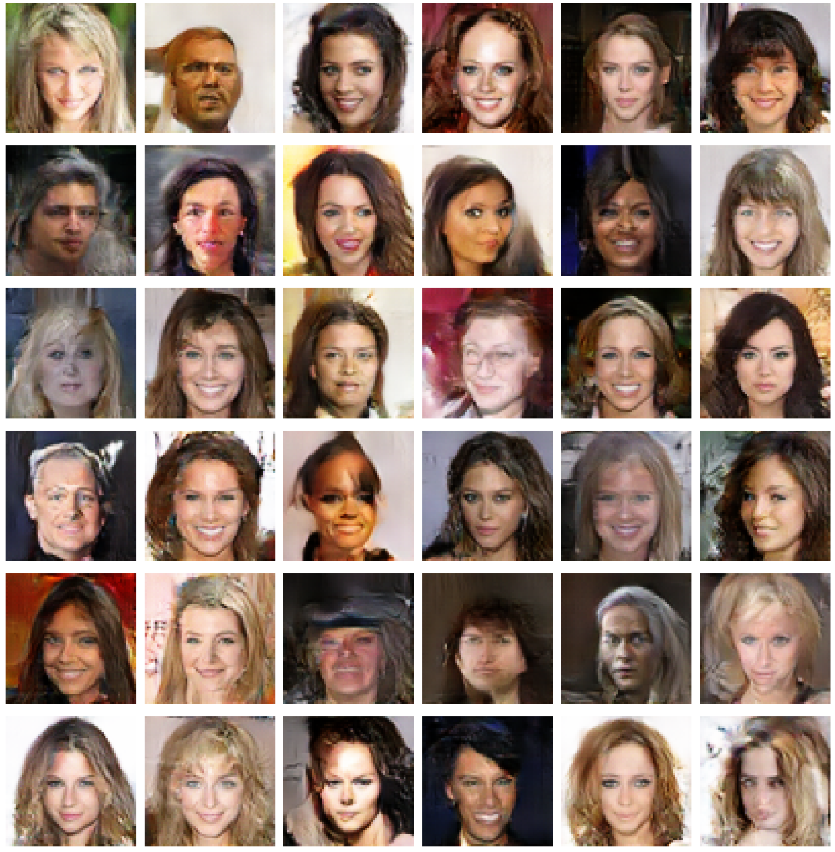
RESULTS
Code Link:https://github.com/Sow-268/TNSDC_Generative-AI.git

